Slide 1


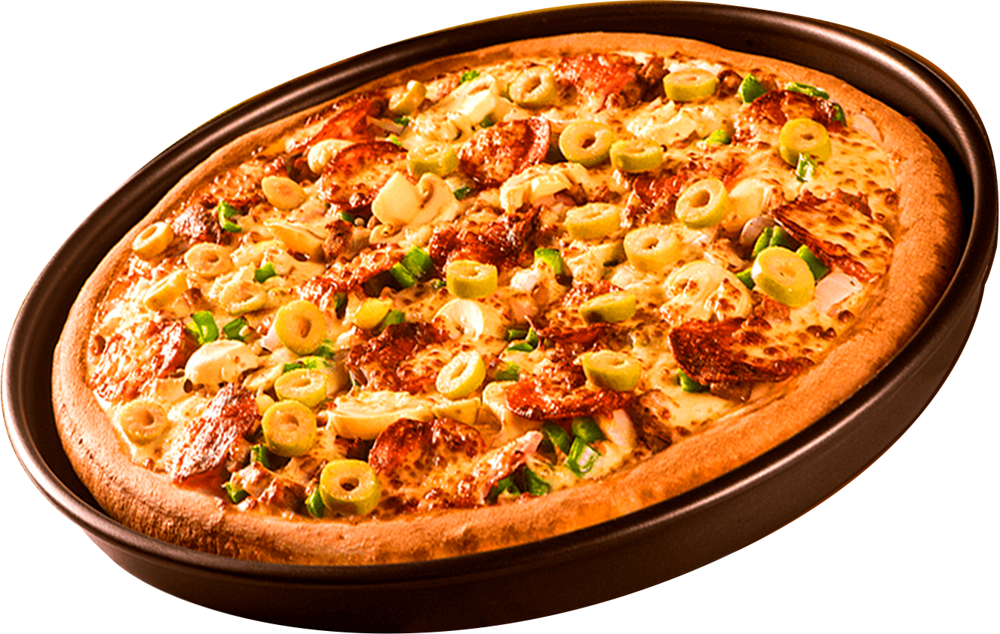
Where Every Slice is a Taste of Perfection
SQL PROJECT ON PIZZA SALES
ORDER
NOW

Slide 2
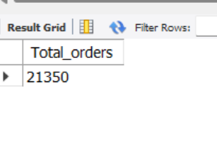
RETRIEVE THE TOTAL NO OF ORDERS PLACED?

Slide 3
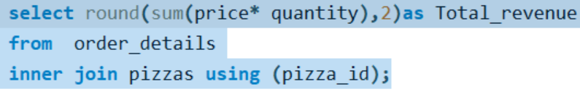
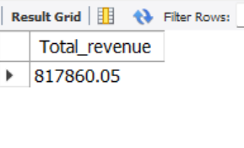
CALCULATE THE TOTAL NO OF REVENUE GENERATED FROM PIZZAS SALES?

Slide 4
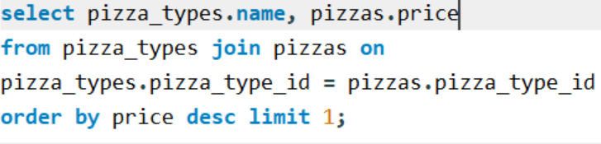
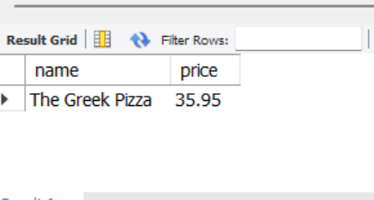
IDENTIFY THE HIGHEST PRICED PIZZA?

Slide 5
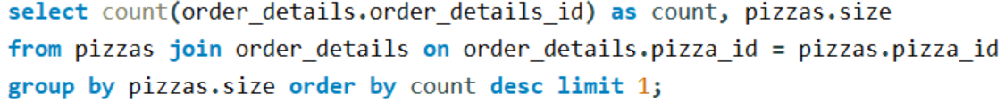
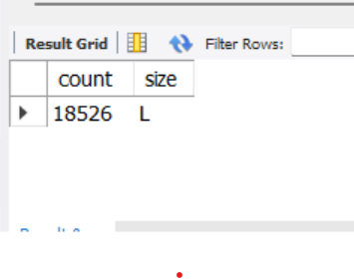
IDENTIFY THE MOST COMMON PIZZA SIZE ORDERED?

Slide 6
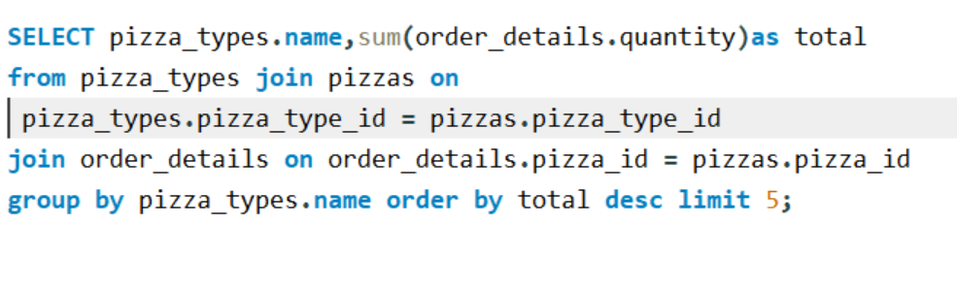
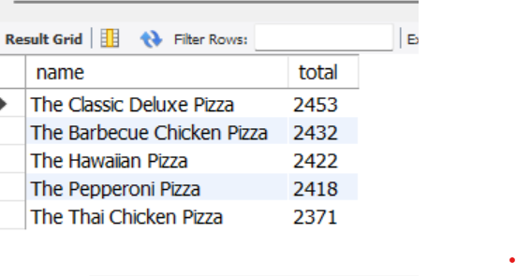
LIST THE TOP 5 MOST ORDERED PIZZA TYPES ALONG WITH THEIR QUANTITIS?

Slide 7
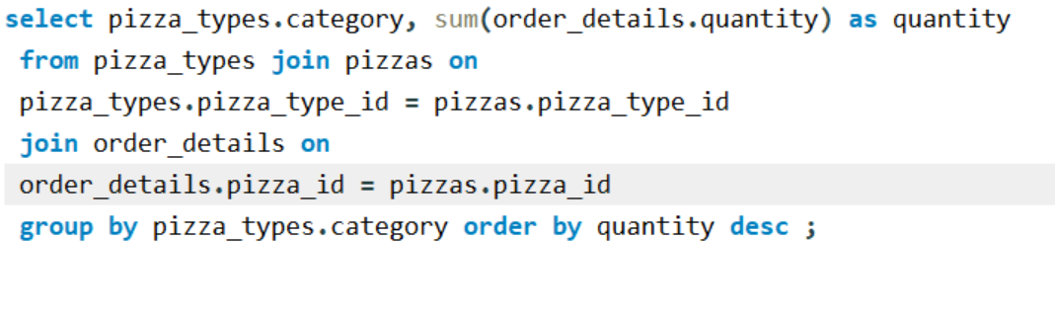
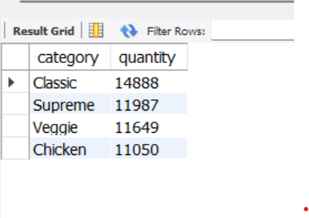
FIND THE TOTAL QUANTITY OF EACH PIZZA CATEGORY?

Slide 8
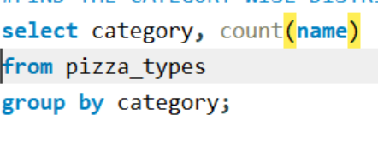
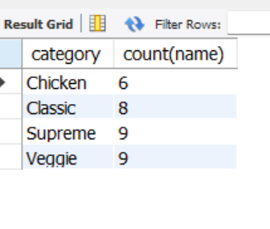
FIND THE CATEGORY WISE DISTRIBUTION OF PIZZAS?

Slide 9
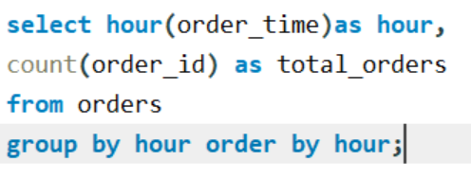
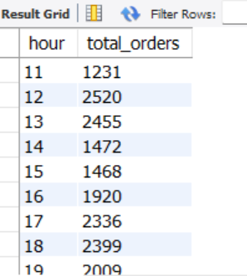
DETERMINE THE DISTRIBUTION OF ORDERS ON HOUR BASIS?

Slide 10
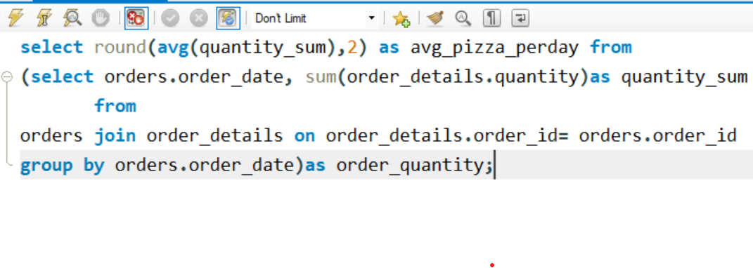
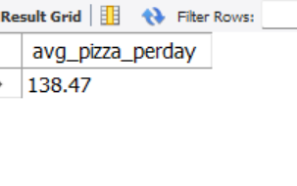
GROUP THE ORDERS BY DATE AND CALCULATE THE AVERAGE NO OF PIZZAS ORDERED PER DAY?

Slide 11
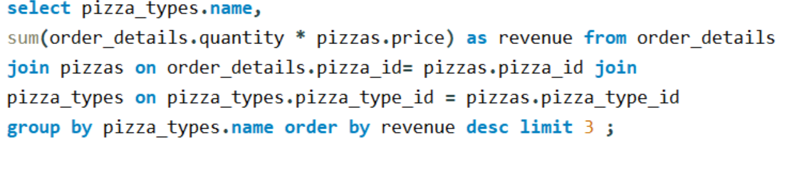
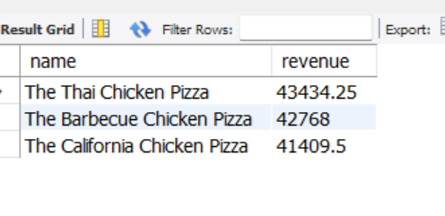
DETERMINE THE TOP 3 MOST ORDERED PIZZA TYPES BASED ON REVENUE?

Slide 12
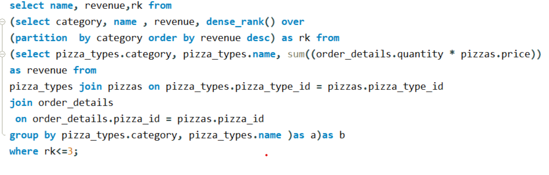
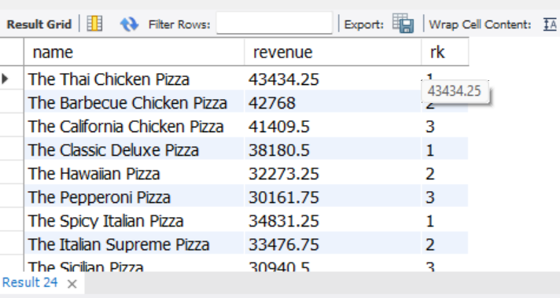
DETERMINE THE TOP 3 MOST ORDERED PIZZA TYPE BASED ON REVENUE FOR EACH PIZZA CATEGORY?

Slide 13
Pizza Resto Presentation
THANK YOU
FOR ATTENTION

